Slide 1
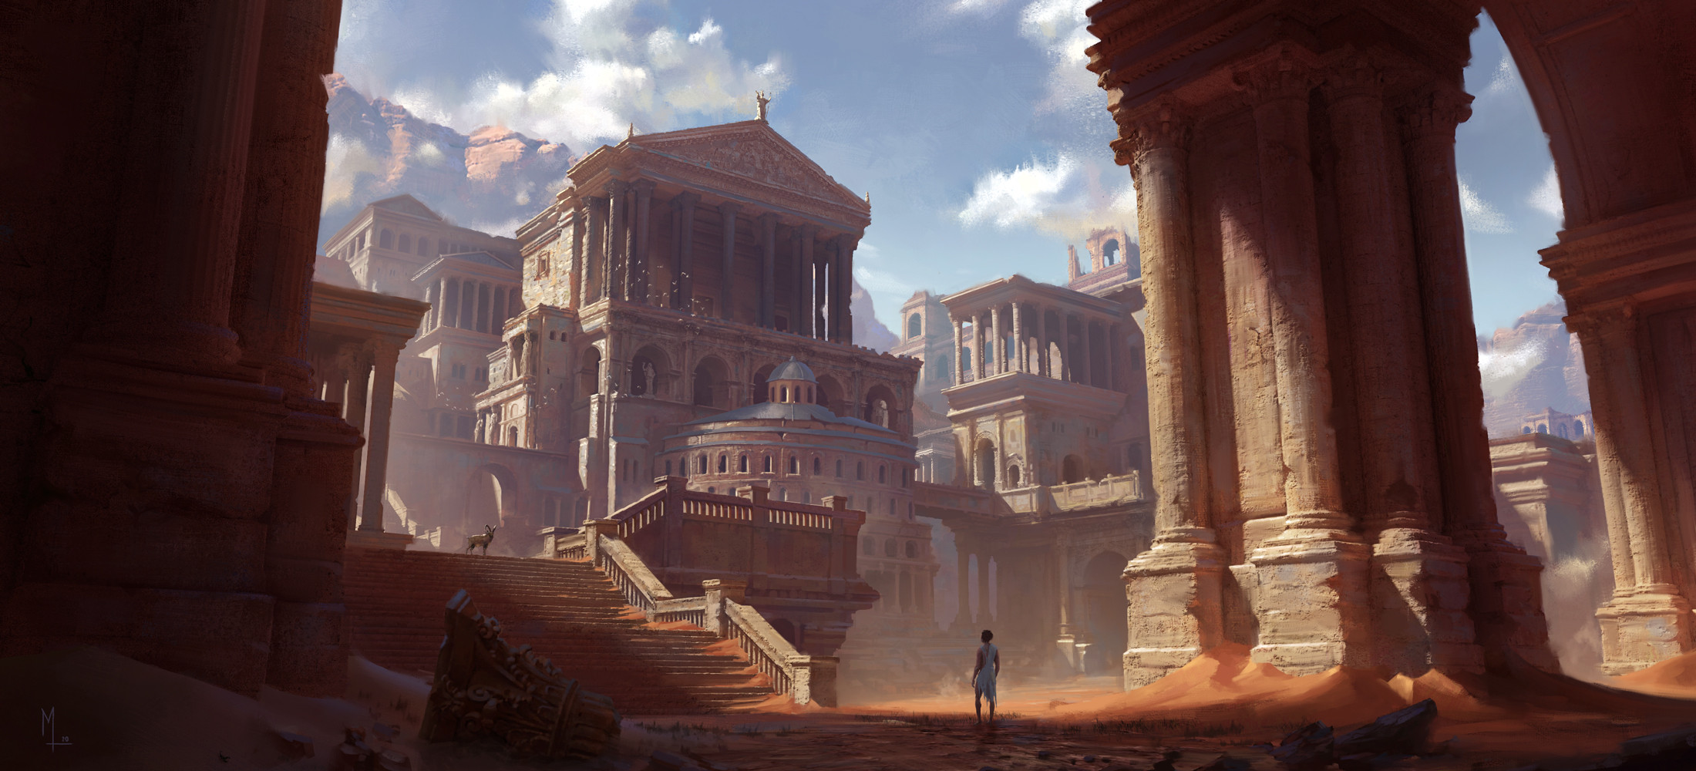
Workshop 3D Environment Creation
Concept Art by Luis Medina – City of Immortals

Slide 2
First things first
Open the unreal project.

Slide 3
Goal of the workshop
Introduction to game graphics and environment creation workflows
In Unreal Engine
Building a small-to-medium sized environment
Old Roman / Greek style inspired
Using Modular Building Blocks
Using Quixel Megascan Assets
Based around a single camera viewpoint
Work by yourself, or in small teams (2-3 persons)

Slide 4
Game Asset Pipeline
Making things look nice

Slide 5
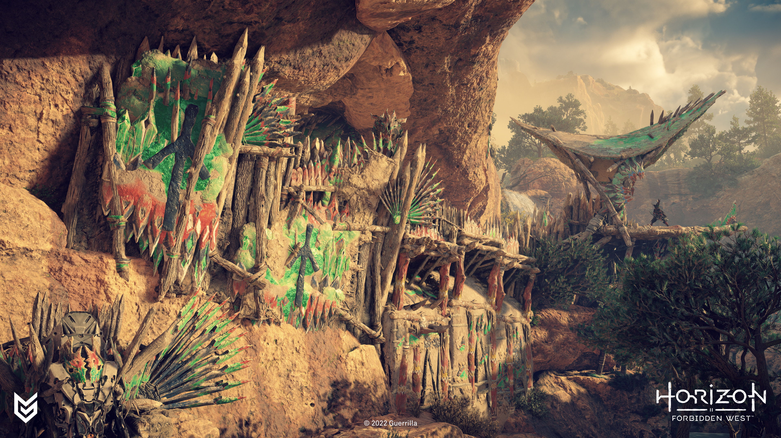

Slide 9
Game Graphics Production
Is a lot about faking things efficiently
Lighting
Reflections
Details
Optimization
LOD’s (level-of-detail)
Texture’s: amount, sizes, channel-packing, uv usage

Slide 10
Make it, then fake it.
Efficiency is key in game graphics development.
Look nice
Render fast
Game Asset Pipeline:
Reference
Low Poly
Bake
High Poly
Texture
Render

Slide 11
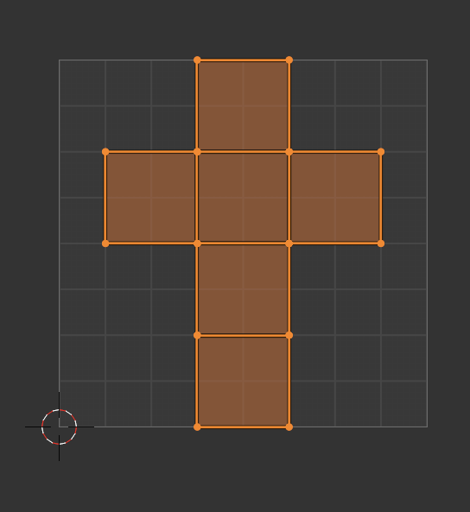
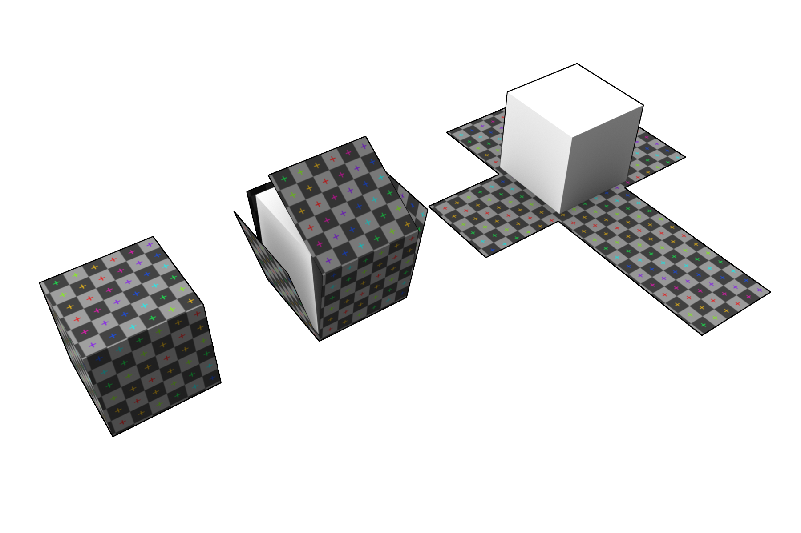
The Basics – 3D Models & UV Unwrapping
UV unwrapping 3D objects allows us to map 2D textures to them

Slide 12
PBR Textures
A texture is an image.
Texture models in UV space. The 2D texture is mapped through your UV unwrap to the 3D model.
Normal map: captures extra details for your model
Color map: colors of the materials
Roughness map: gives material variation, grunge, dirt, …
Metalness map: something is metal, or it is not
Ambient occlusion map: shows ambient shadows in a fully lit environment
…

Slide 13
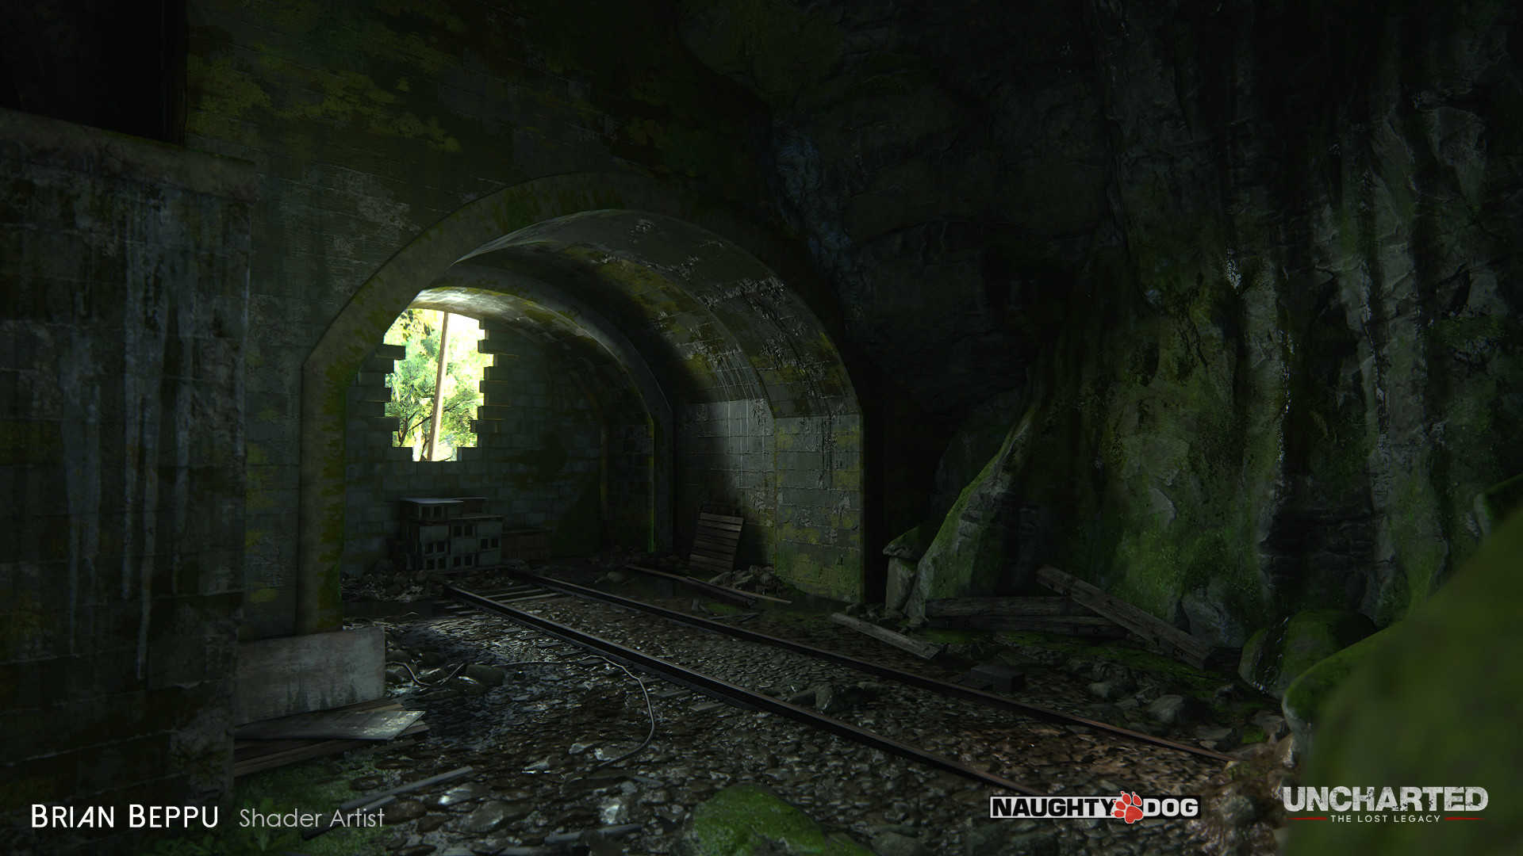
Real Time Graphics
Realtime Physically Based Rendering
Diffuse and Specular reflections
Color
Fresnel Effect
Metals and non-metals
Driven by textures providing information about these properties (excl. Fresnel)

Slide 14
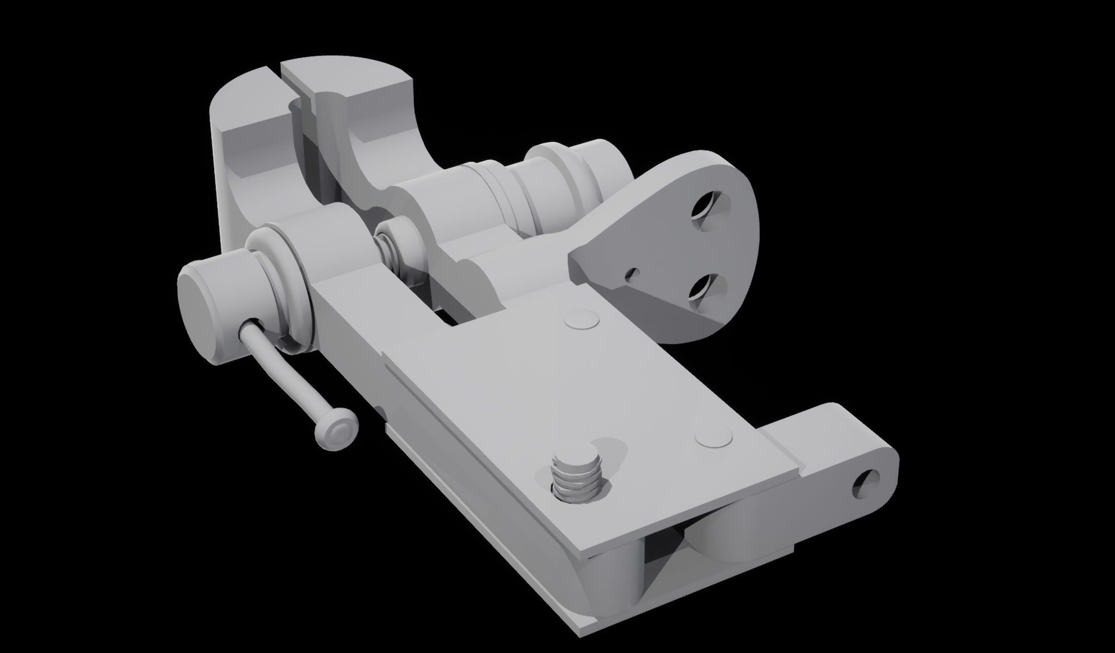

Low Poly
High Poly

Slide 15
High Poly
Low Poly

Slide 16
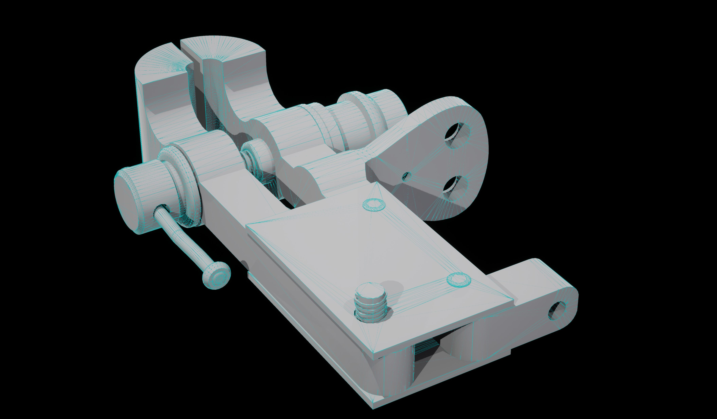
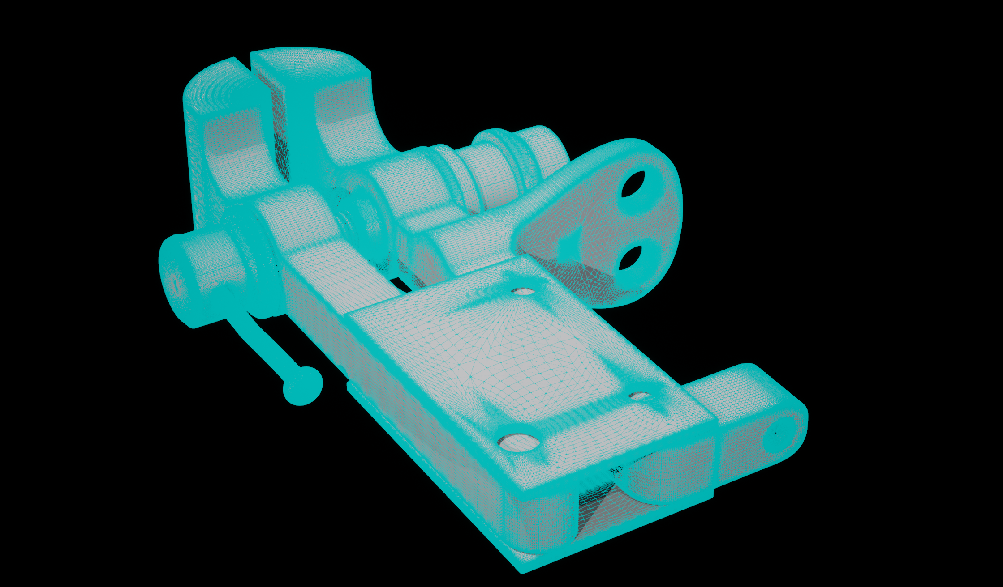
Low Poly
High Poly

Slide 17
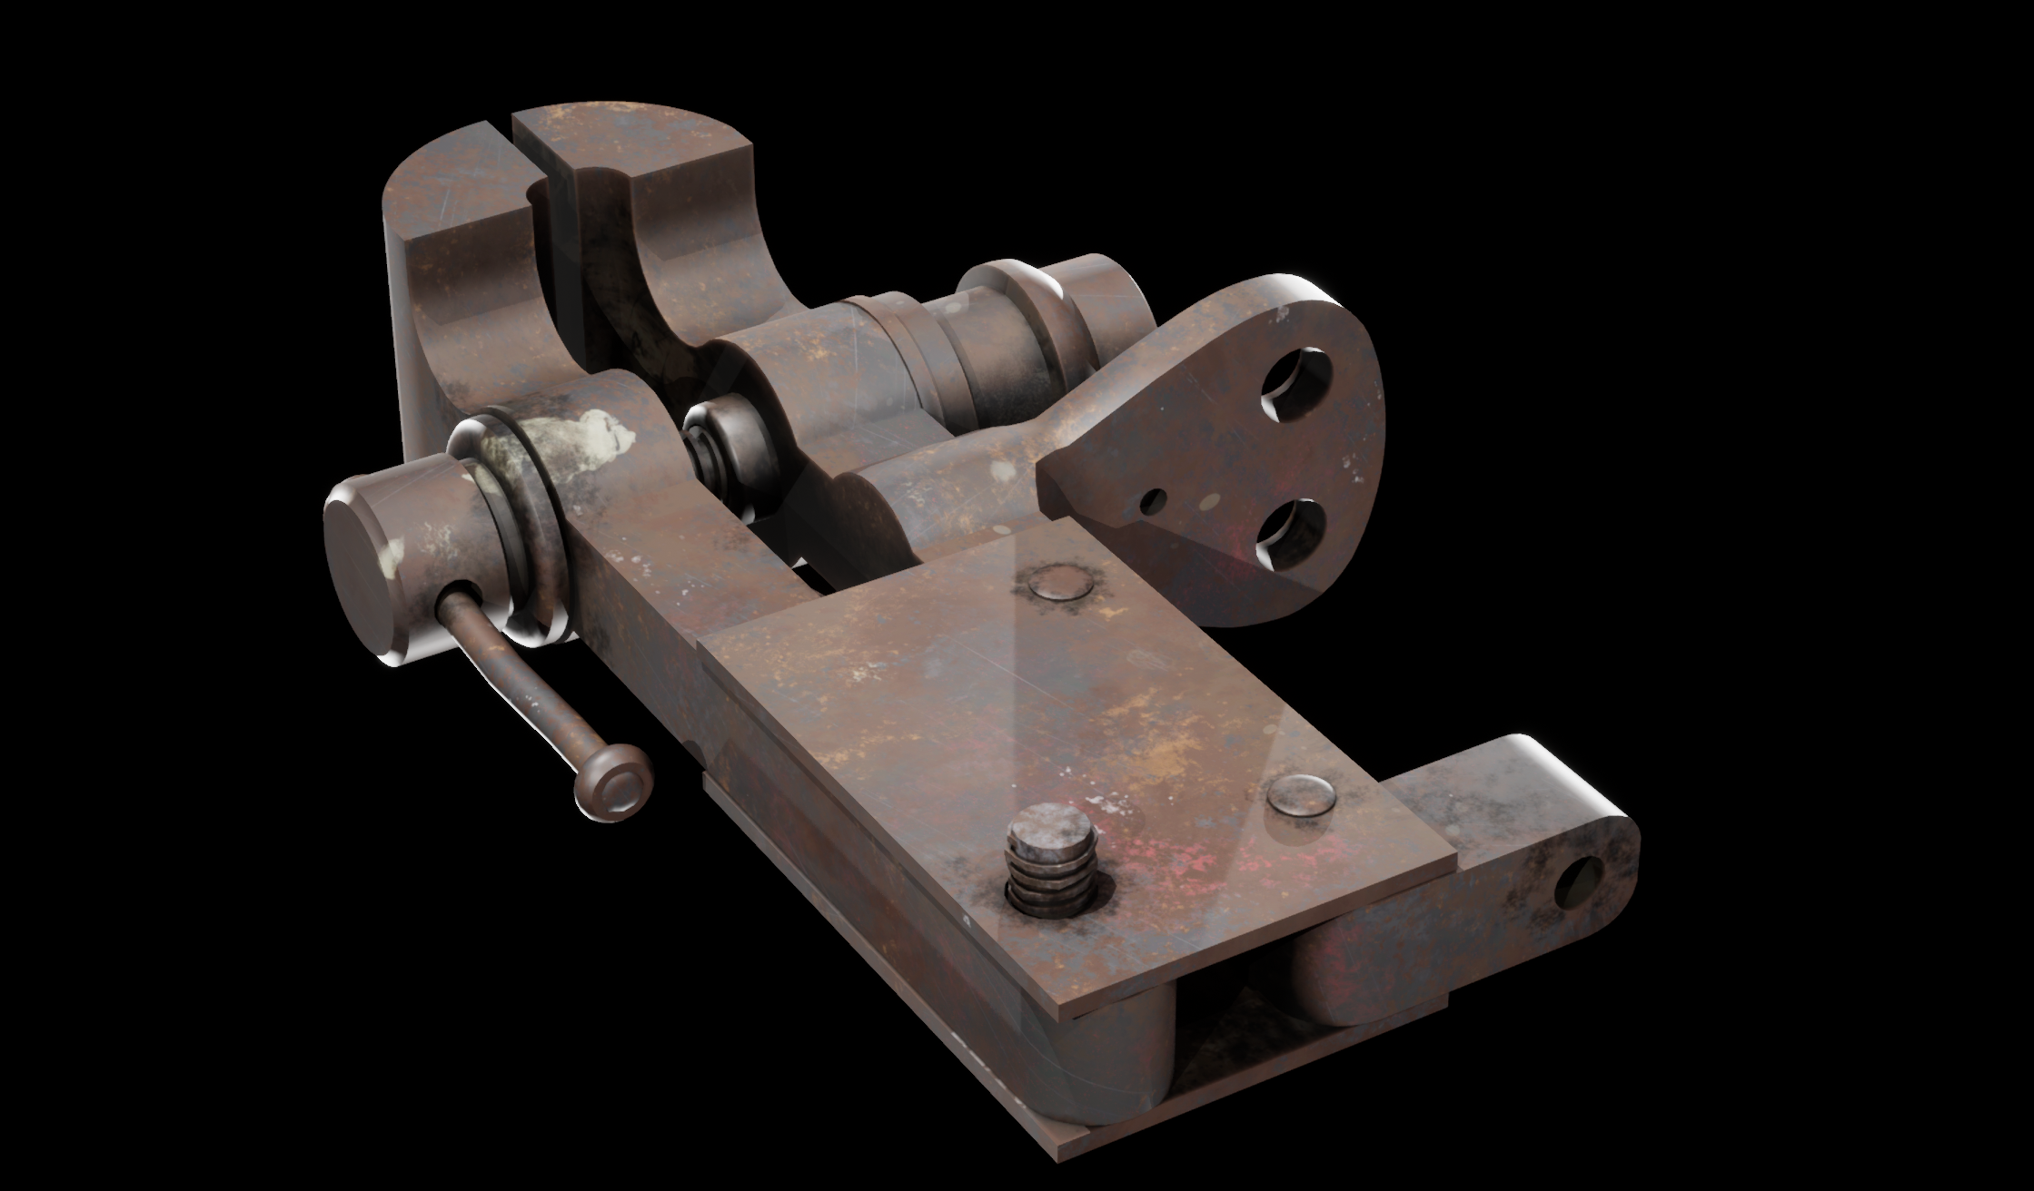
Low Poly
+color

Slide 18
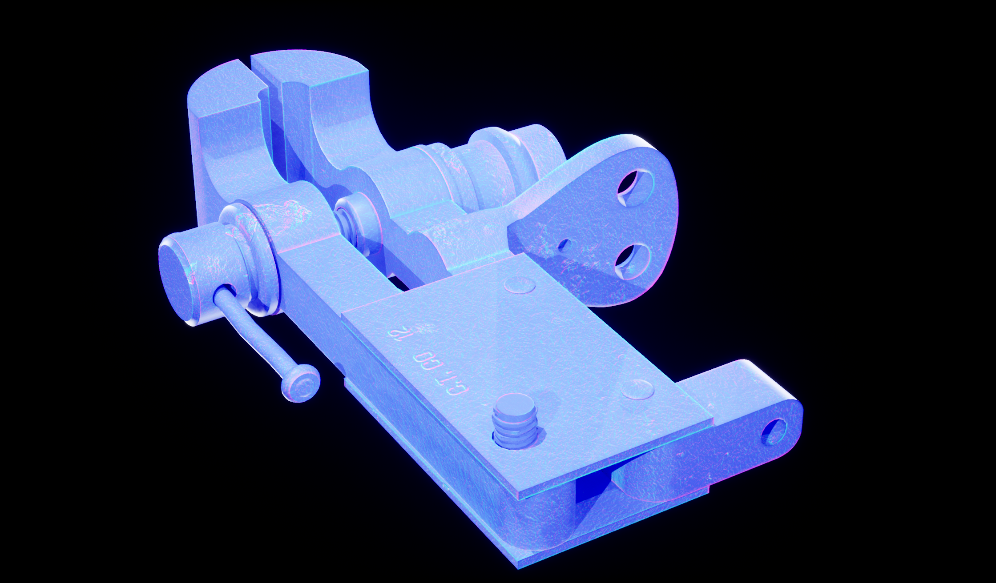
Low Poly
normal map
Don’t model what can be textured

Slide 19
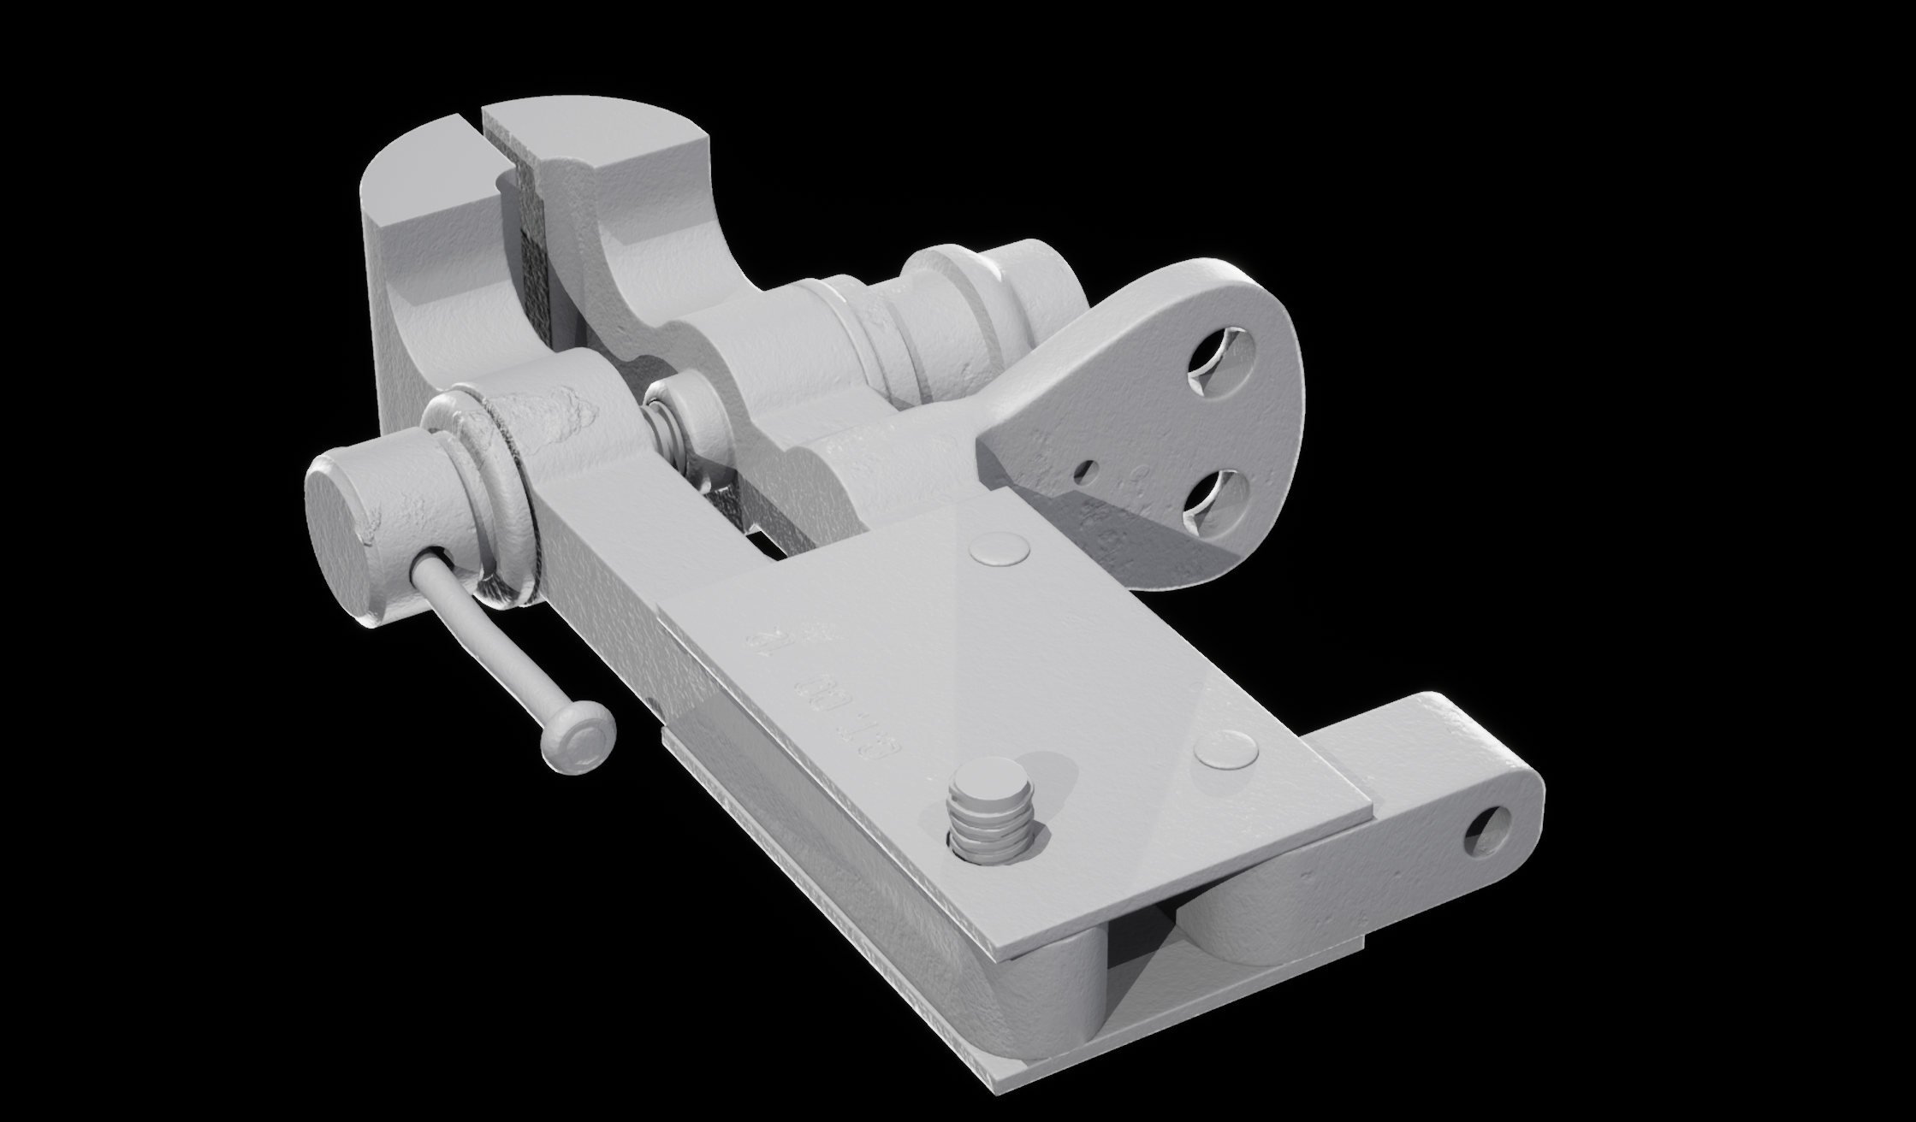
Low Poly
+normal map

Slide 20
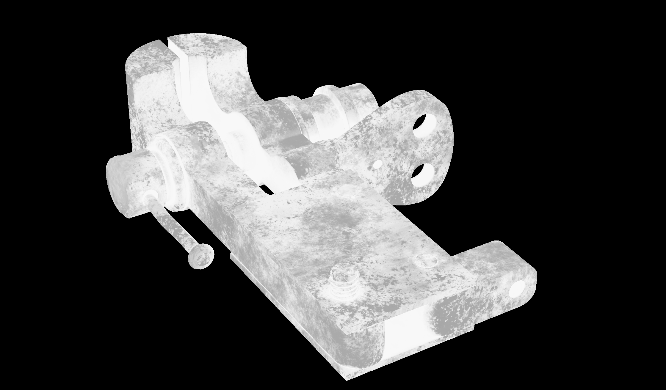
Low Poly
roughness

Slide 21
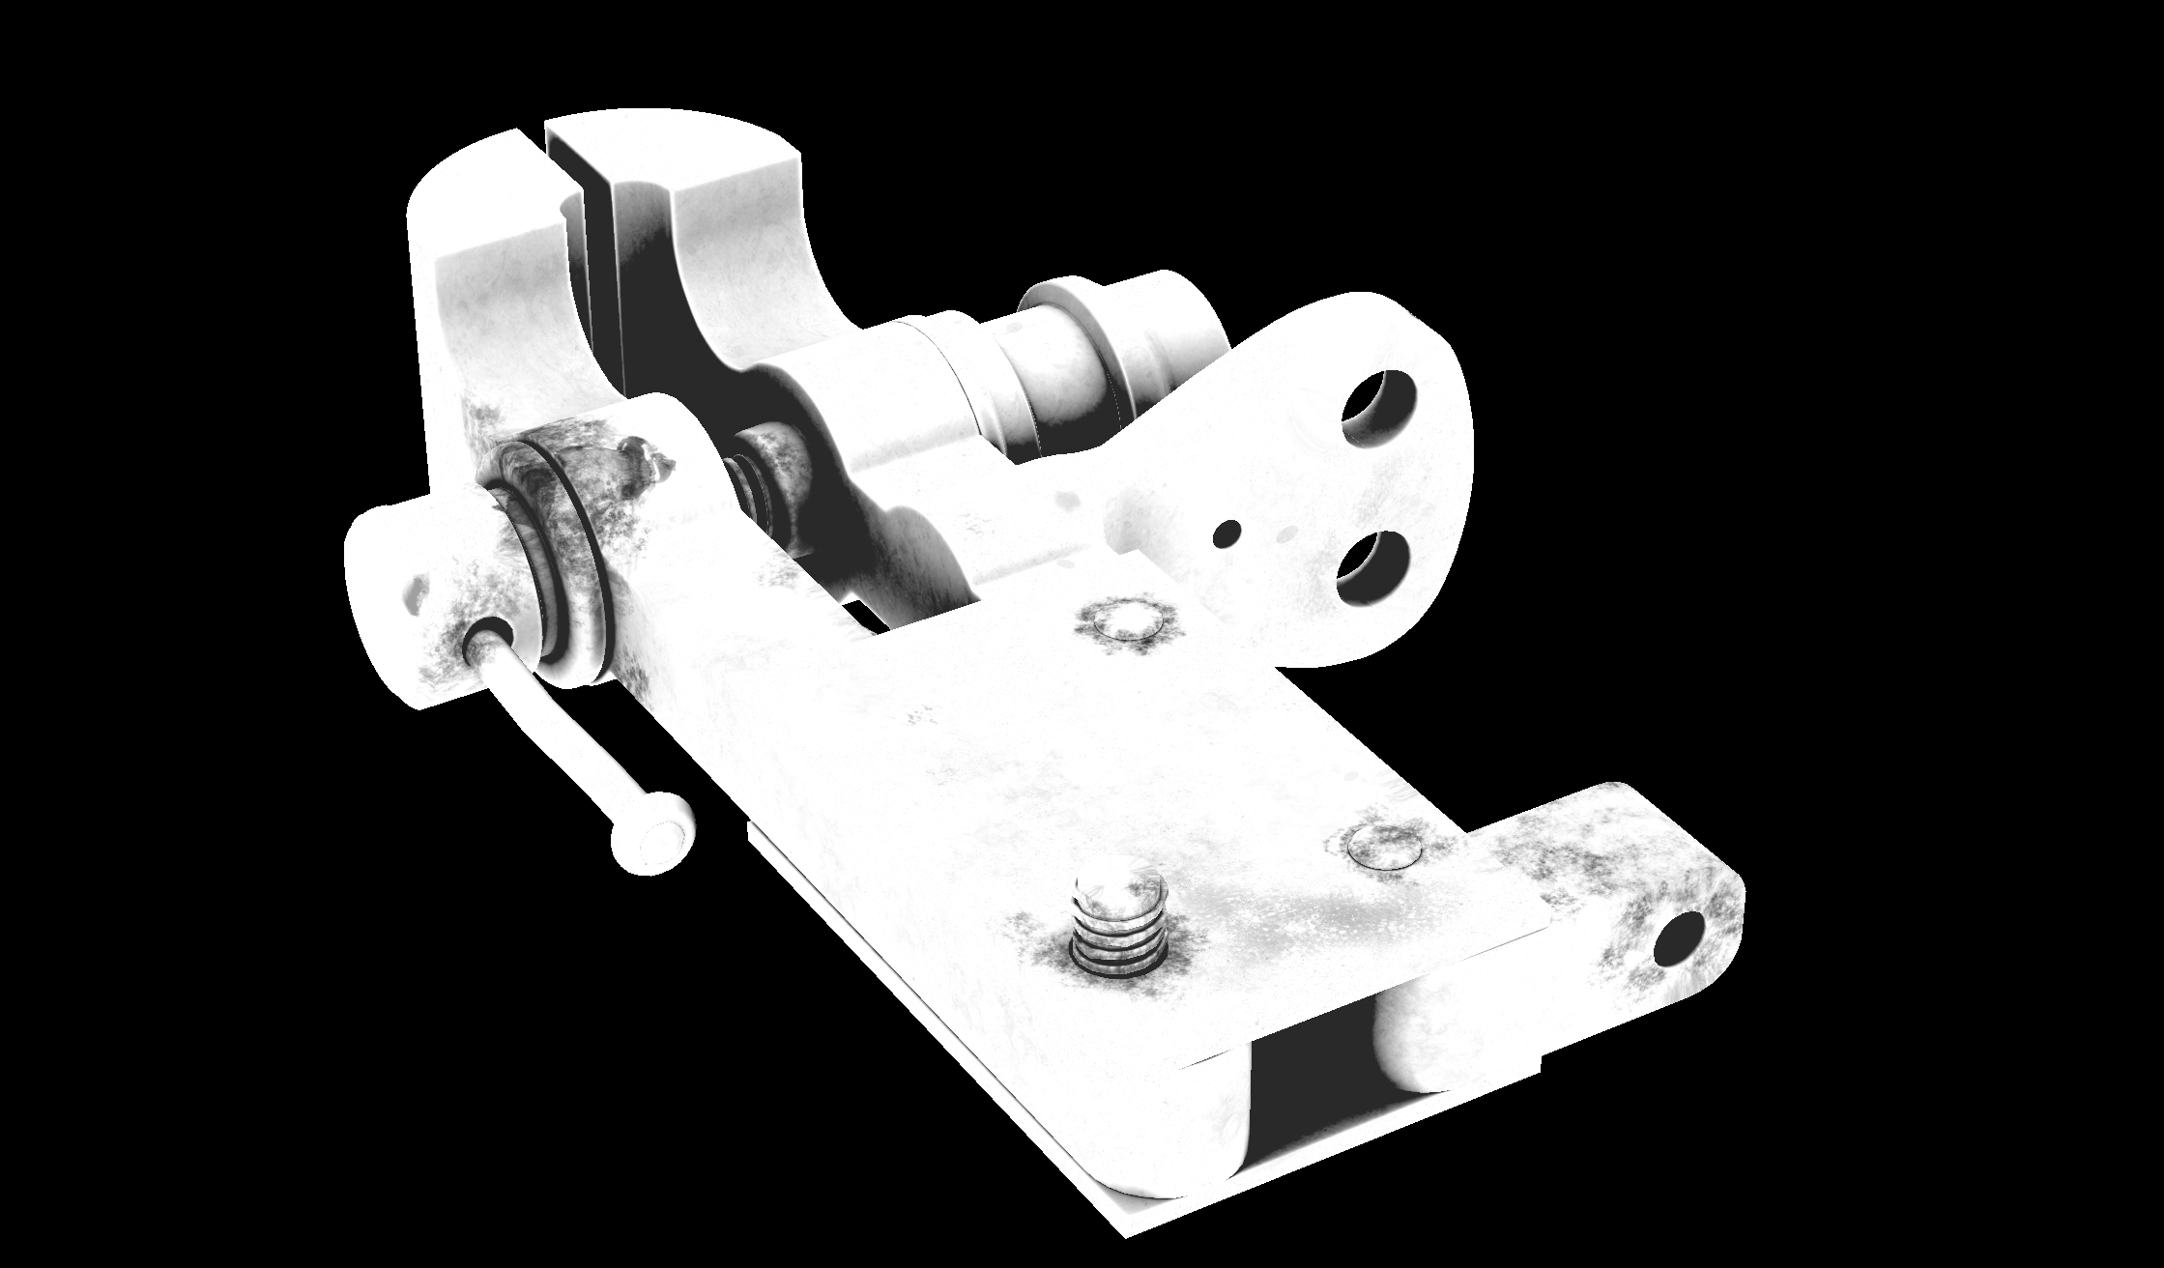
Low Poly
metalness

Slide 22
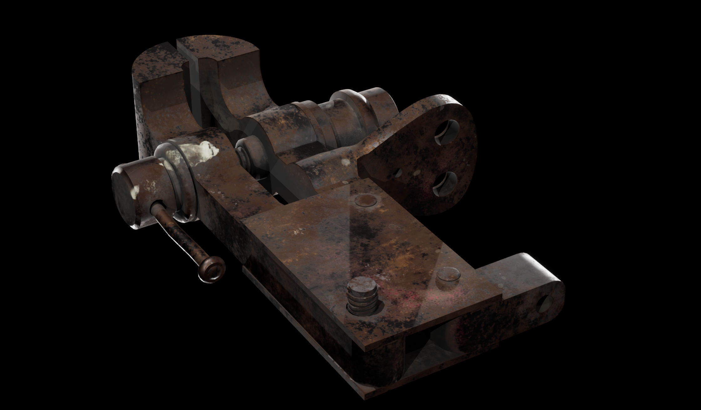
Low Poly
+color
+roughness
+metalness

Slide 23
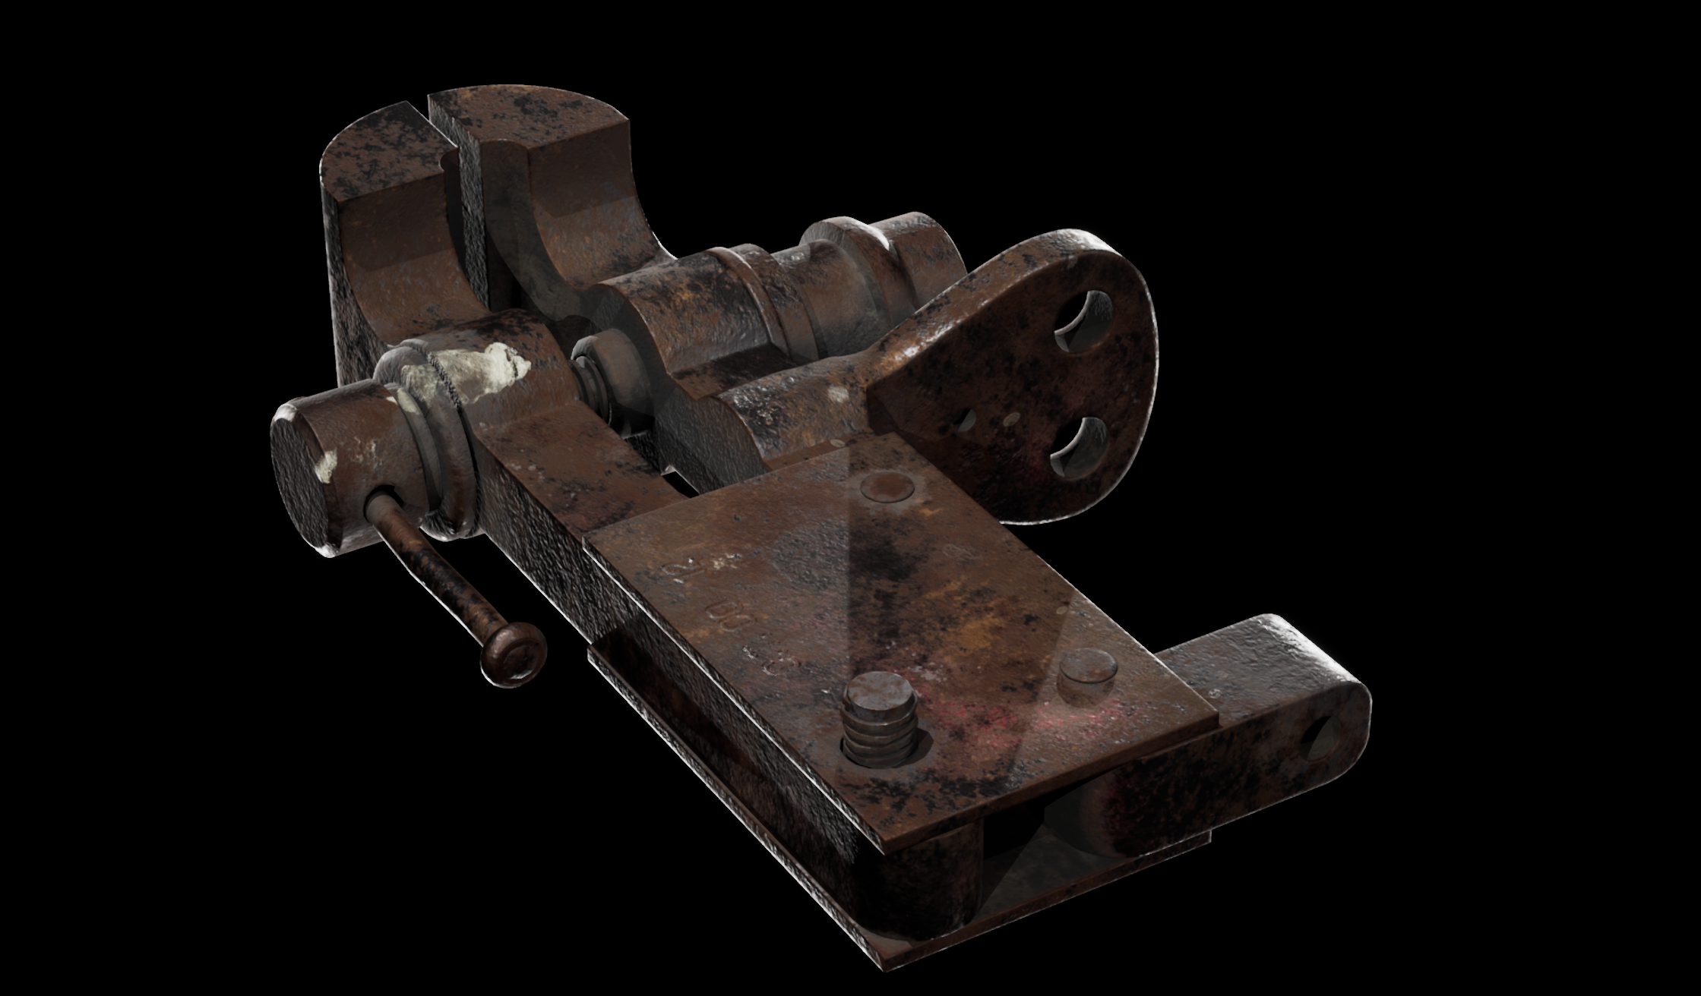
Low Poly
+color
+roughness
+metalness
+normal

Slide 24
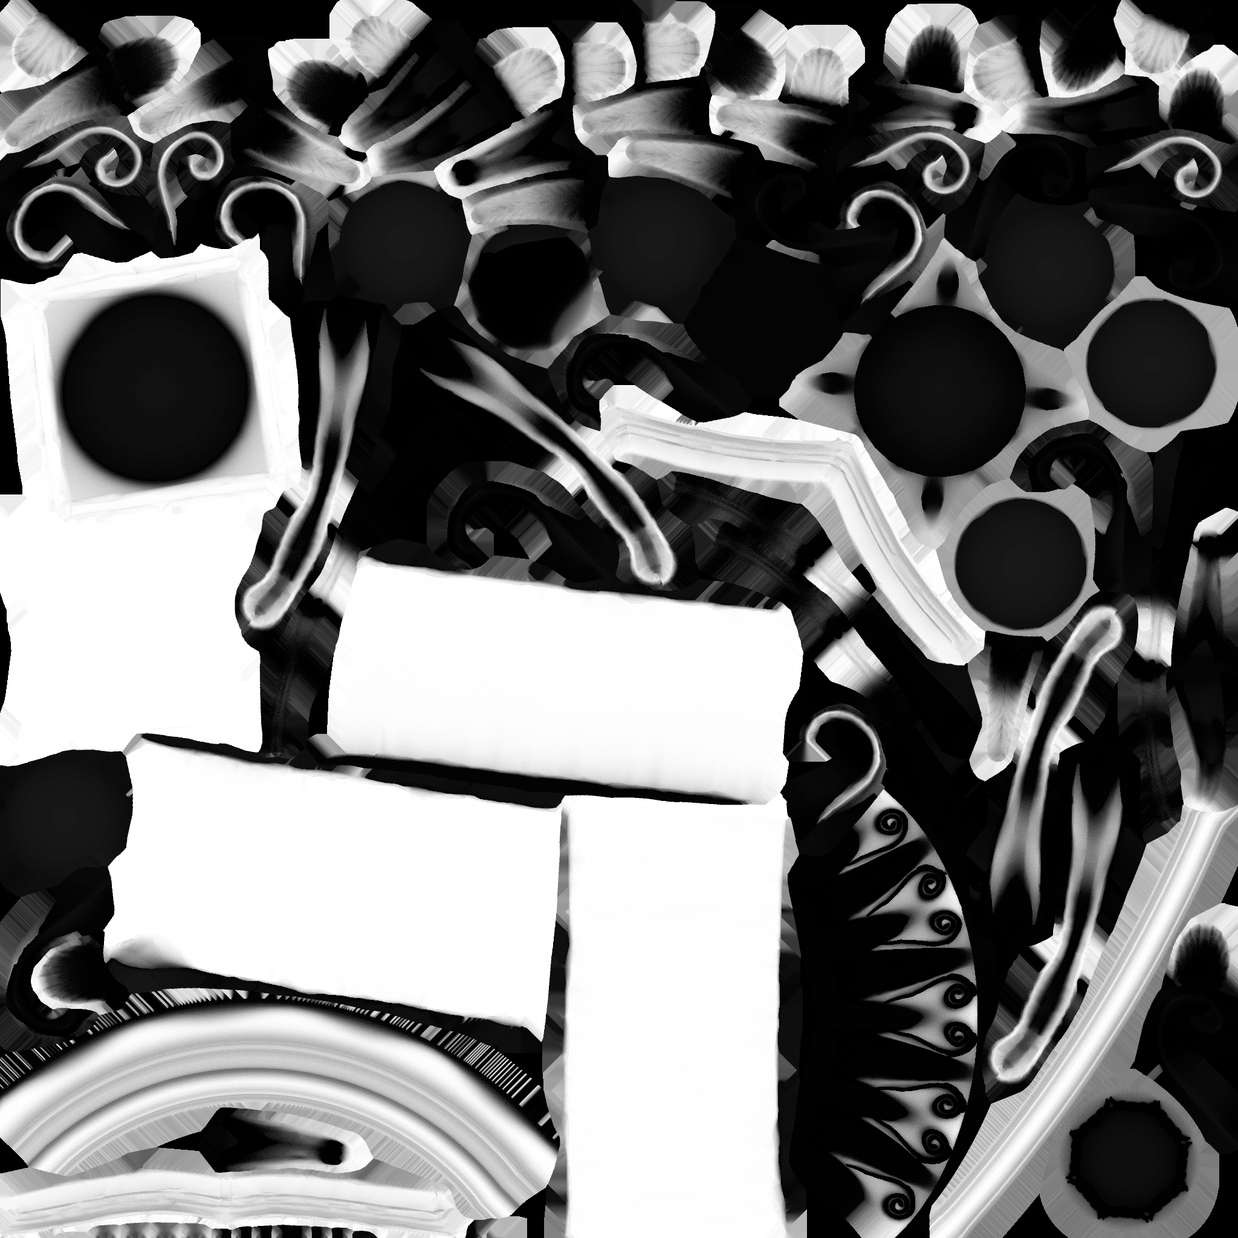
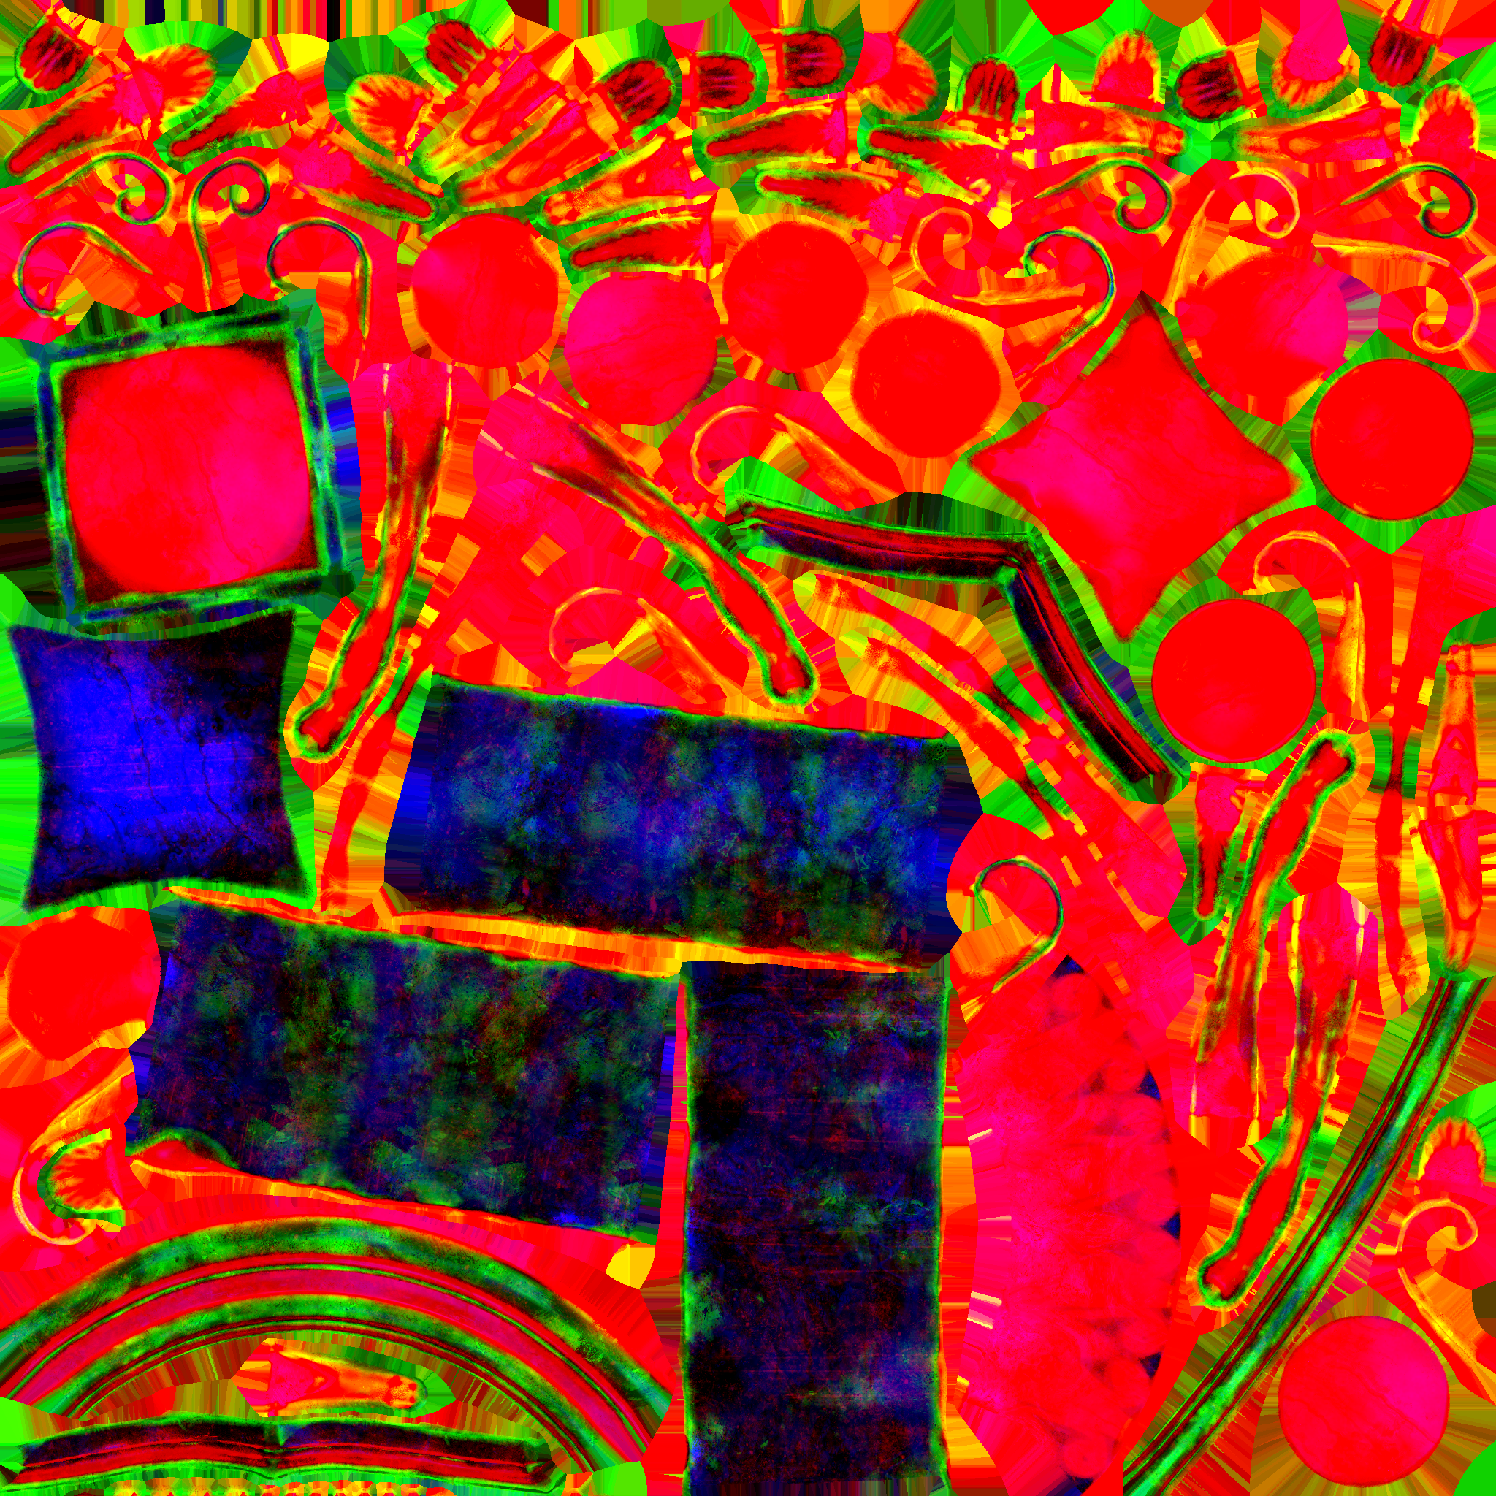
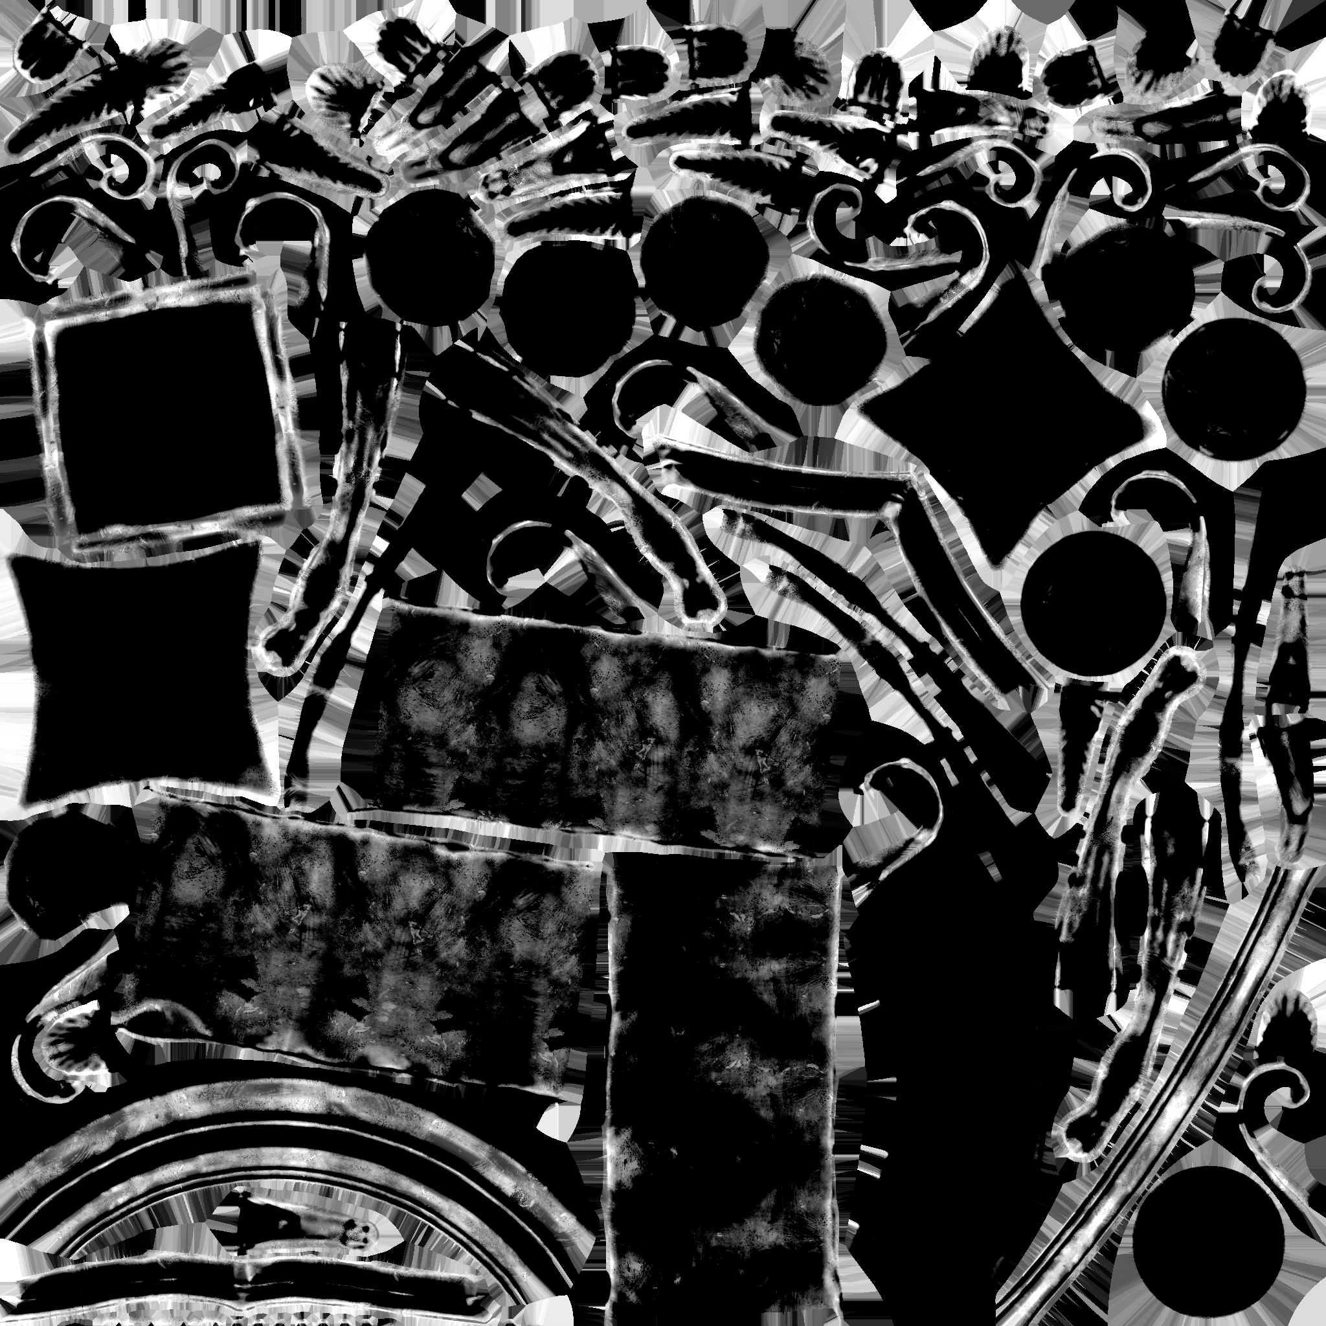
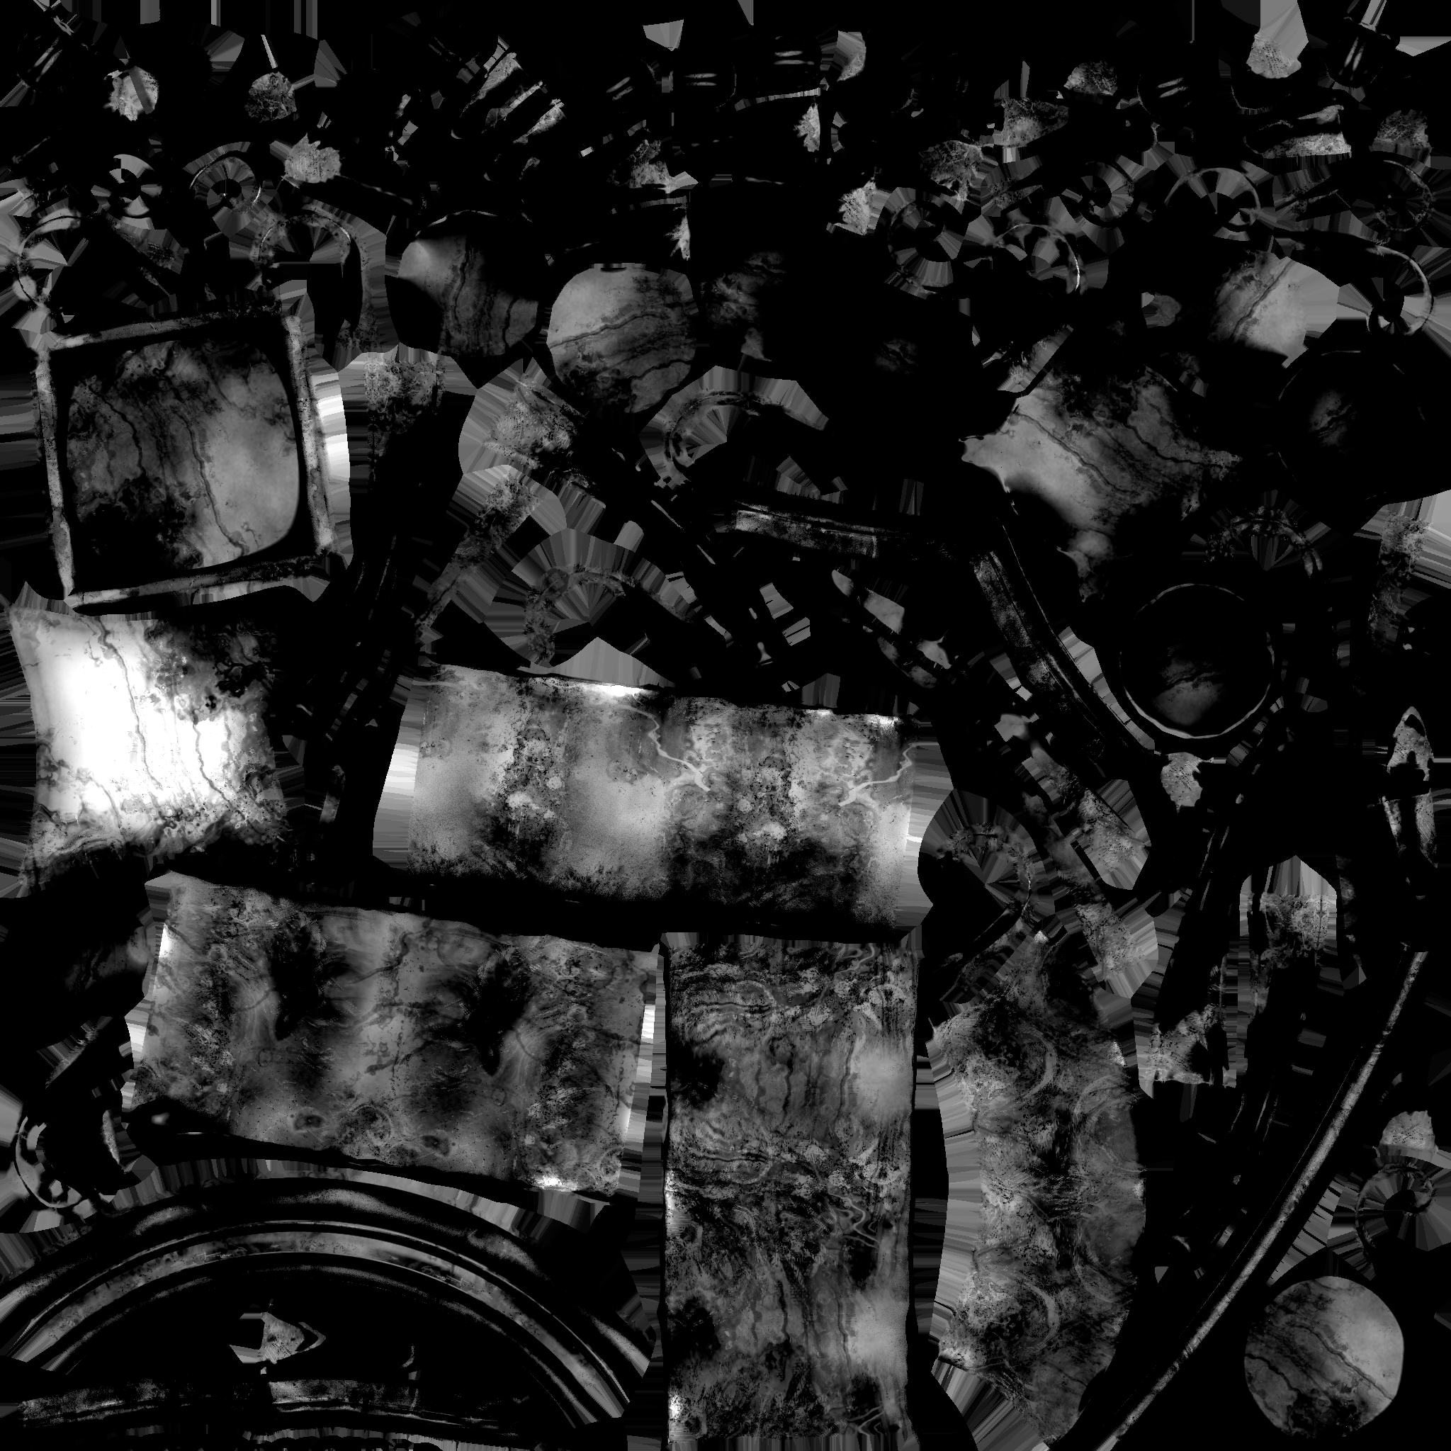
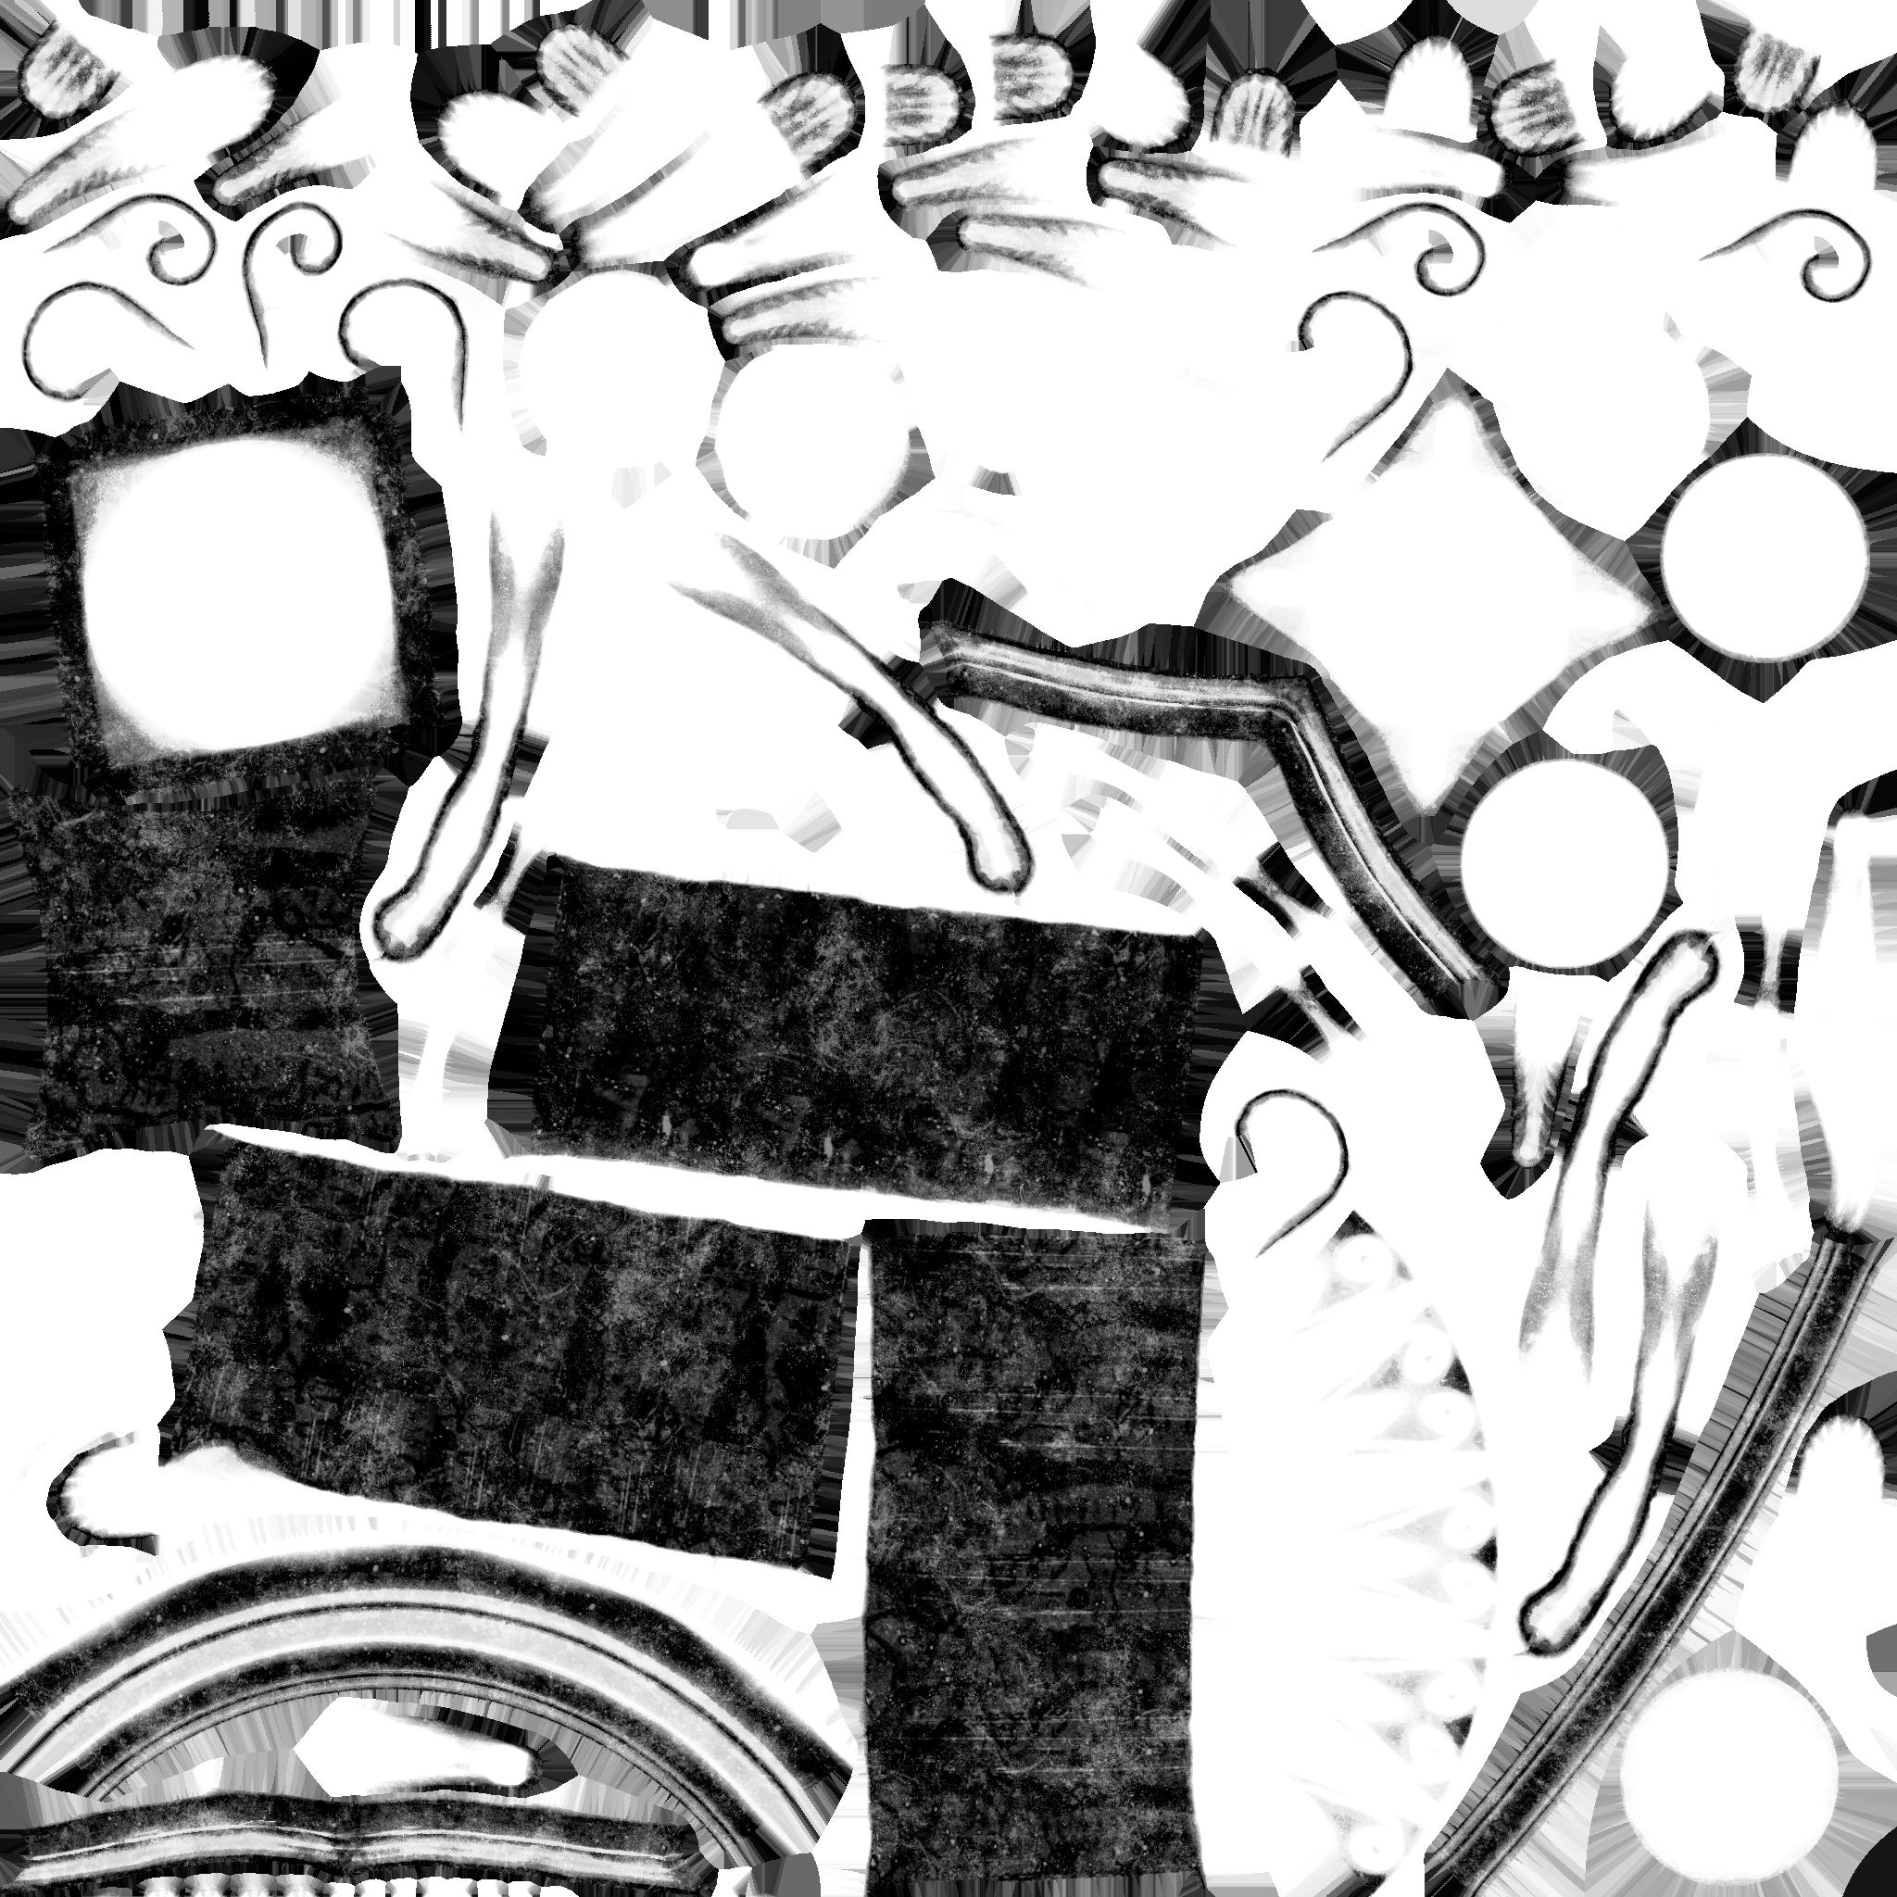
Alpha
Channel Packing
Green
Blue
Red

Slide 25
Goal of the workshop
Introduction to game graphics and environment creation workflows
In Unreal Engine
Building a small-to-medium sized environment
Old Roman / Greek style inspired
Using Modular Building Blocks
Using Quixel Megascan Assets
Based around a single camera viewpoint
Work by yourself, or in small teams (2-3 persons)

Slide 26
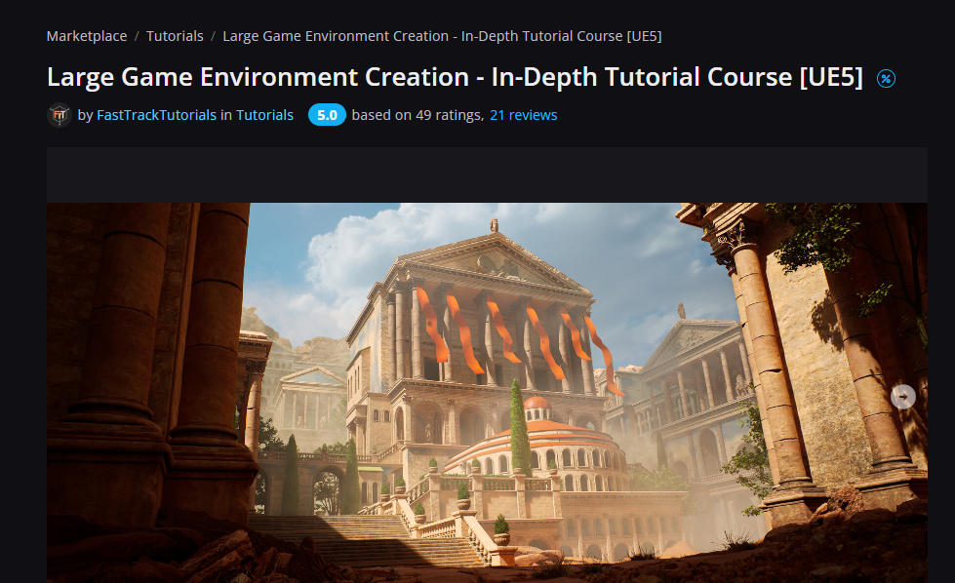
Based on tutorial by Emiel Sleegers – Senior Environment Artist
https://www.artstation.com/marketplace/p/8O1qz/large-game-environment-creation-in-depth-tutorial-course-ue5

Slide 27
Reference Concept Art
Concept Art by Luis Medina – City of Immortals

Slide 28
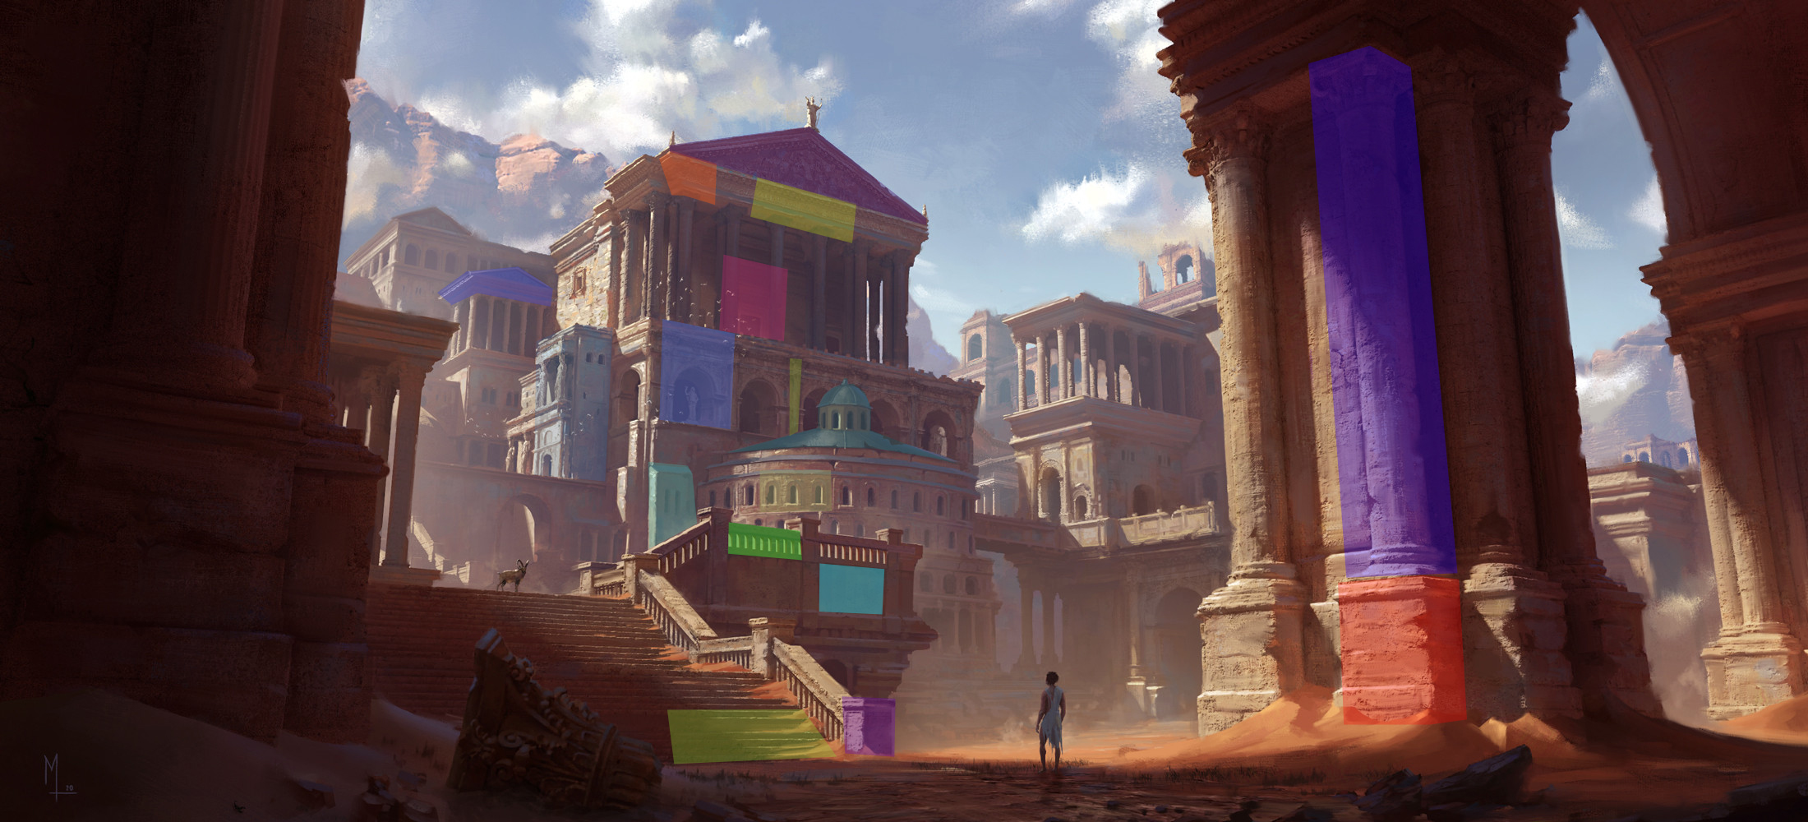
Modular Workflow

Slide 29
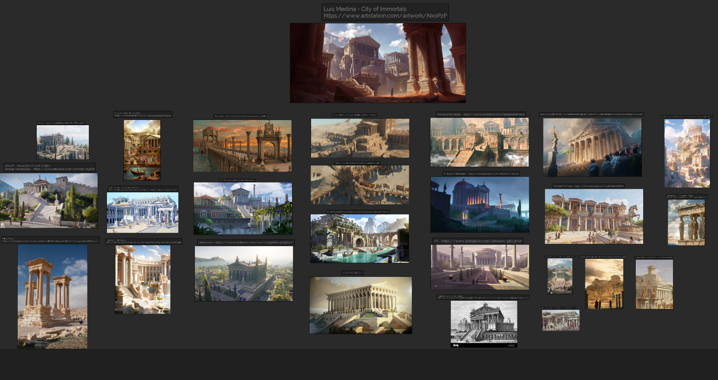

Slide 30
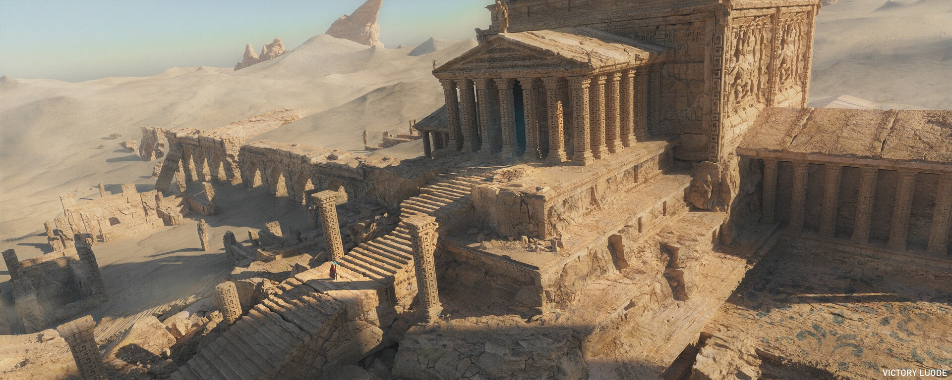
Victory Luode - https://www.artstation.com/artwork/d0JG93

Slide 31
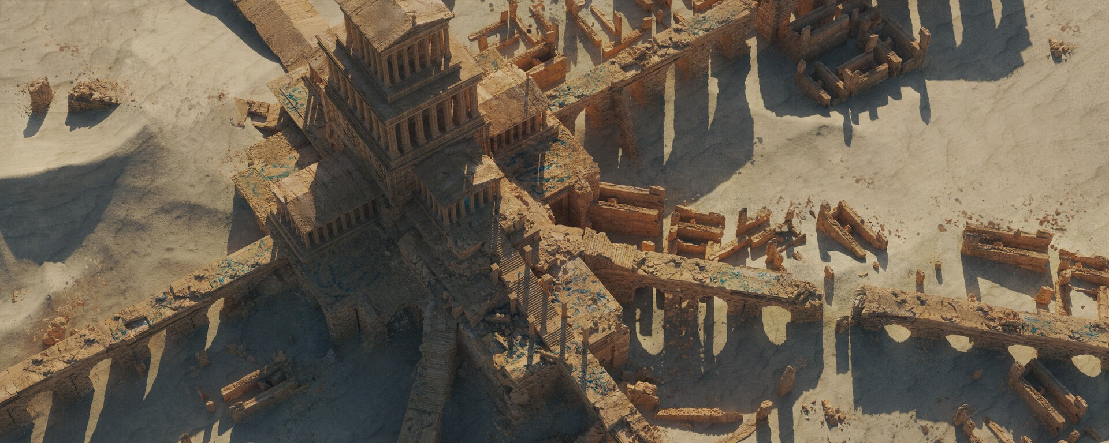
VictoryLuode - https://www.artstation.com/artwork/xYAdbW

Slide 32
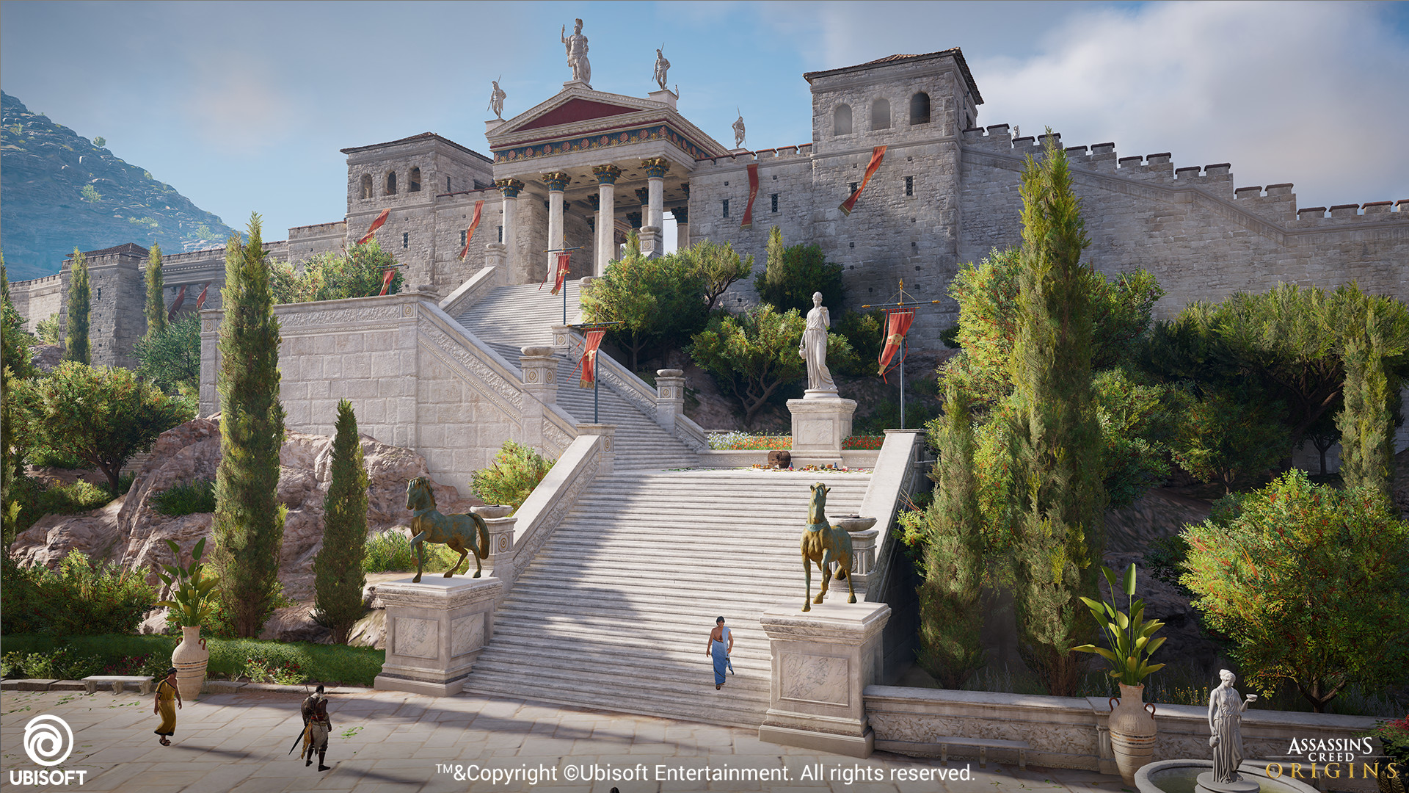
Ubisoft - Assassin's Creed Origins
George Vourdoulas
https://www.artstation.com/artwork/n58bE

Slide 33
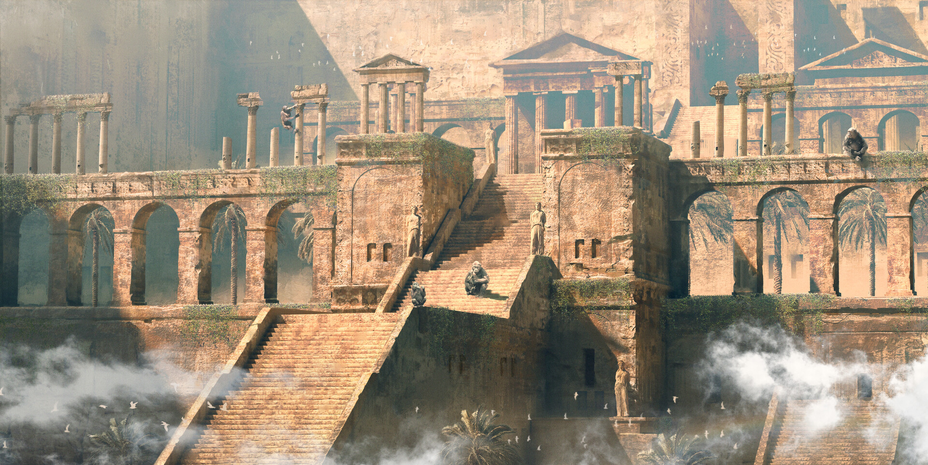
Kentaro Kameda - https://www.artstation.com/kentarokameda

Slide 34
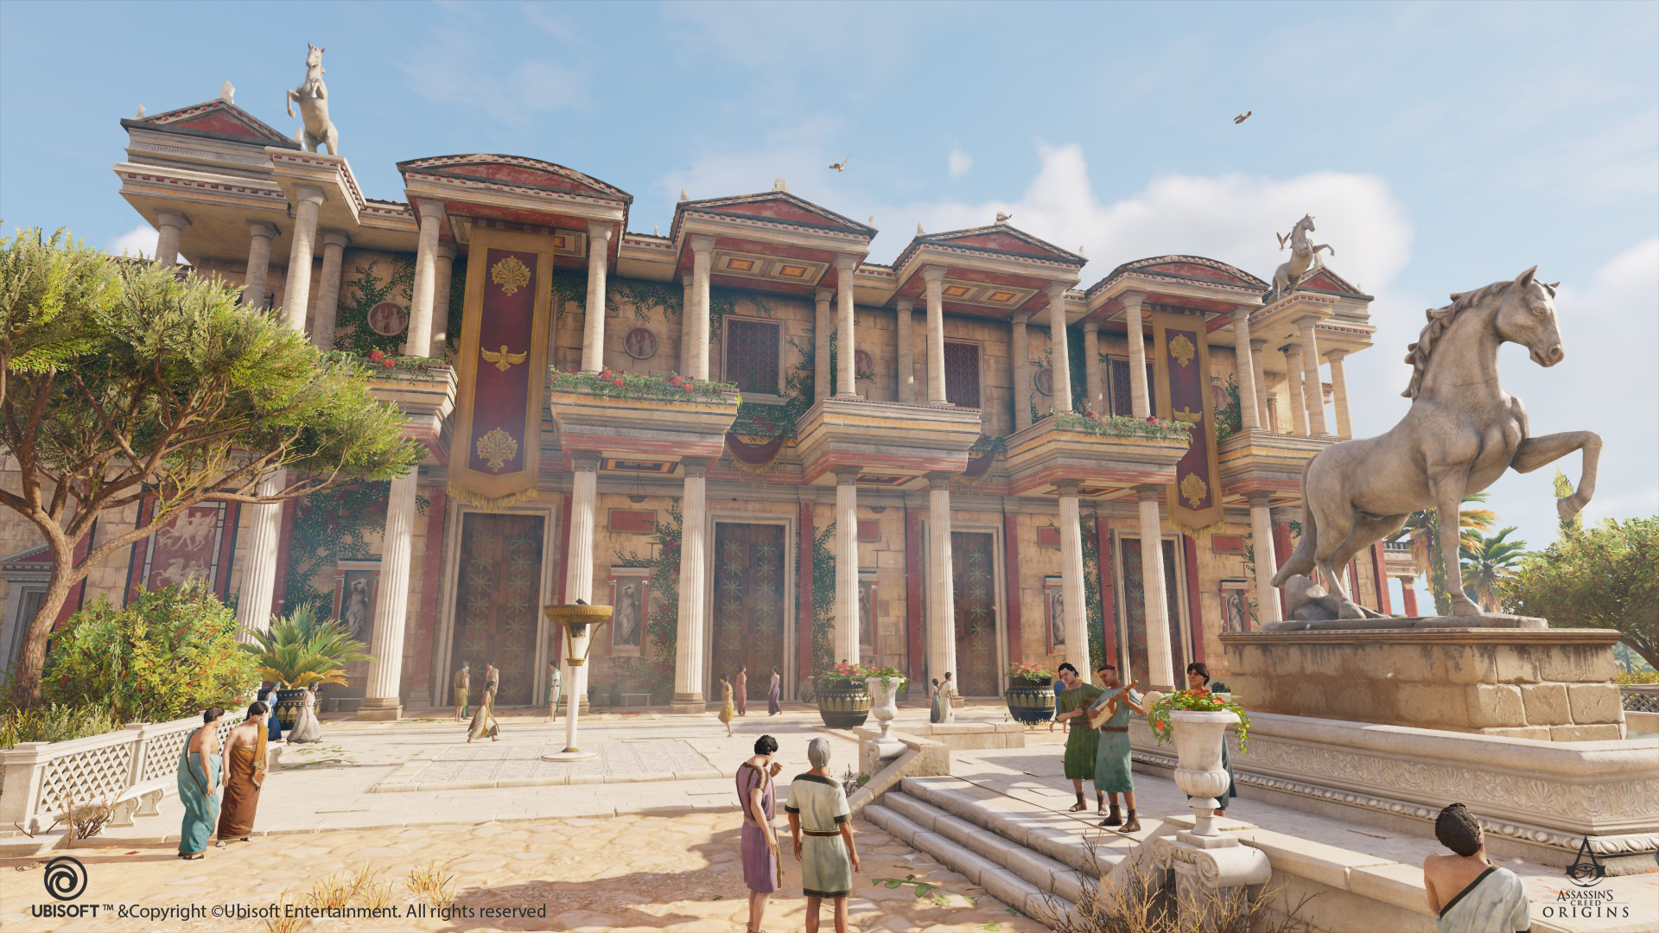
Christian Chihaia - https://www.artstation.com/artwork/6qQb6

Slide 35
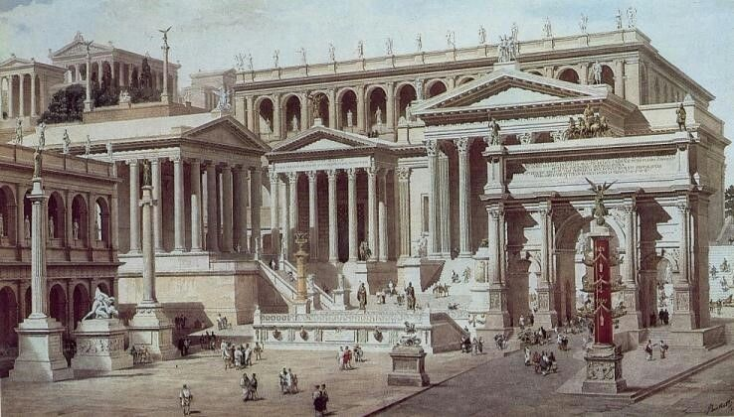
Unknown - https://www.pinterest.com/pin/68961438032672577/

Slide 36
How to approach this
Build by approximation
Don’t build what can’t be seen
Smashing stuff together is fine
Inserting large cubes / default shapes to fill up space is fine
Add tri-planar materials to these (they don’t require UV’s)
Re-use where possible
Don’t go too large scale – time is limited
End Result => High Resolution Screenshot :)

Slide 37
Planning
Before Lunch
Introduction
Split into groups
Load the project
Unreal Engine 101
Quick Blockout (+/- 30 minutes) + Determine View Point / Camera
After Lunch
Build the environment
Lighting Pass / Exponential Fog / Color Corrections
Mega Scans & Assets
Terrain & Foliage
Lastly
Screenshots
Bragging

Slide 38
Showcase – Getting Started
Unreal Engine 101, Blockout, Modular Building, Sharing Merged Assets, Landscape Editor

Slide 39
Cheat sheet?

Slide 40
Showcase – Polishing
Landscape, Foliage, Lighting, Vertex Painting, Megascan Assets, Screenshots

